Slide 1


CHENNAI HOUSE PRICE PREDICTION – REGRESSION PROBLEM TO PREDICT PRICE OF THE PROPERTY
BY BIJU K M

Slide 2

UNDERSTANDING THE CLIENT PROBLEM STATEMENT:
Buyer want to find a fair price for their homes
Sellers want to understand what factors are fetching more money for the houses
Important factors that contribute towards the price
Forecast price range to help the buyer to negotiate (Interval estimator)

Slide 3
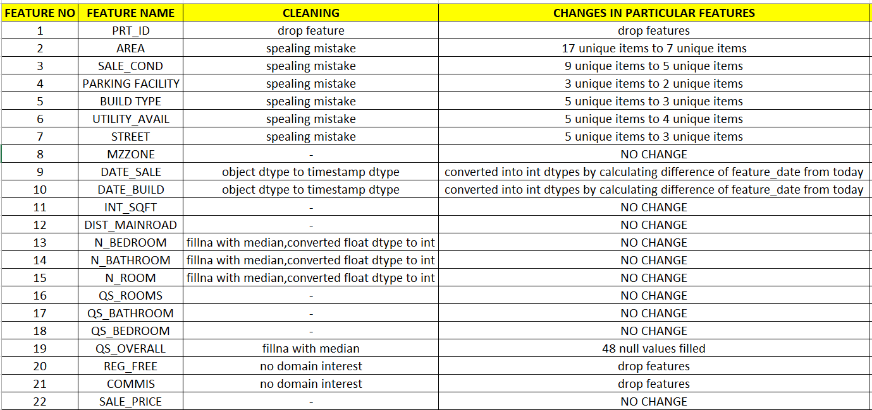
CLEANING OF DATA :

Slide 4
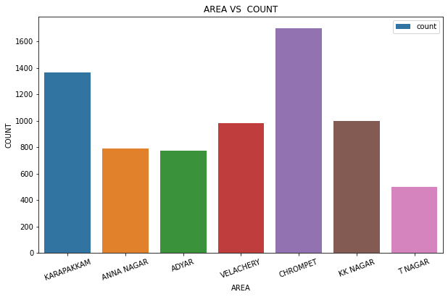
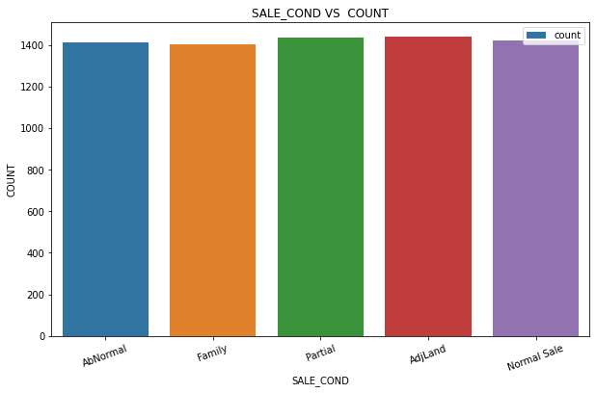
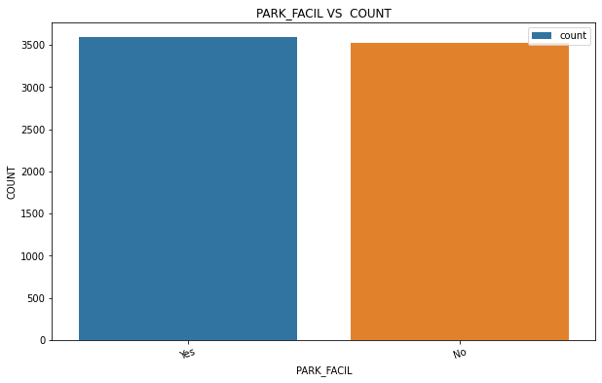
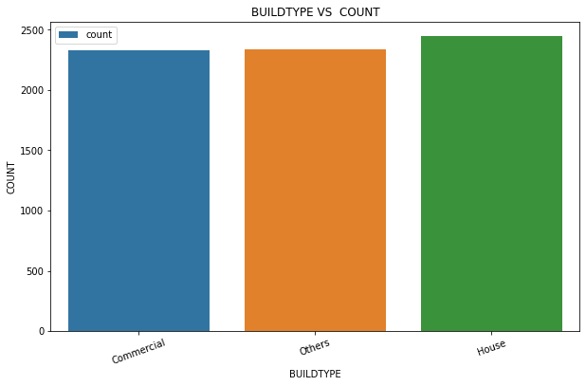
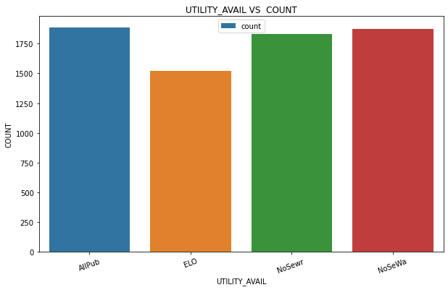
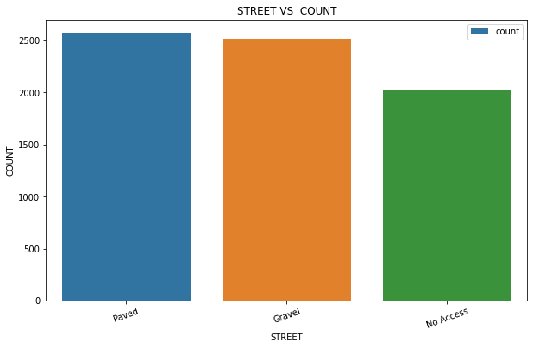
INDIVIDUAL FEATURES EDA ANALYSIS:

Slide 5
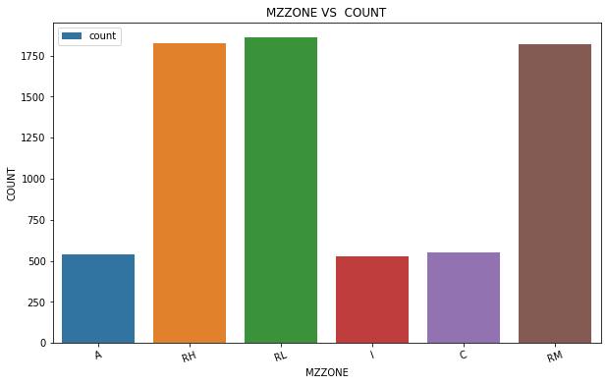
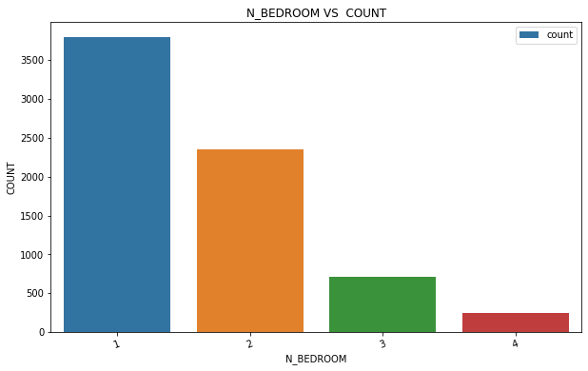
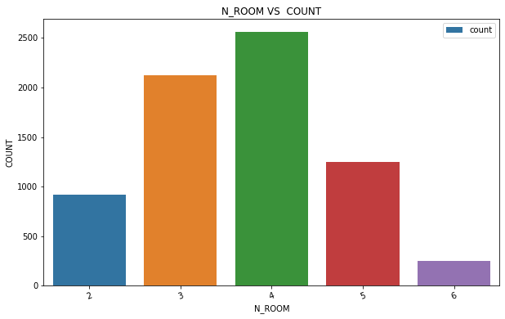
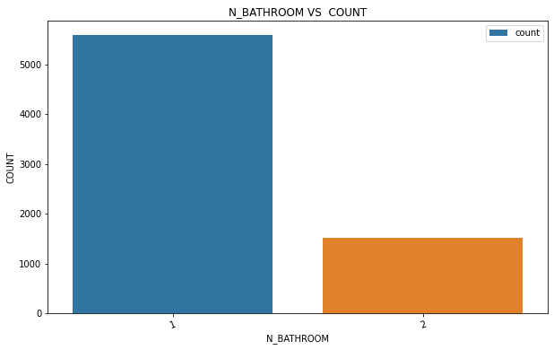

Slide 6
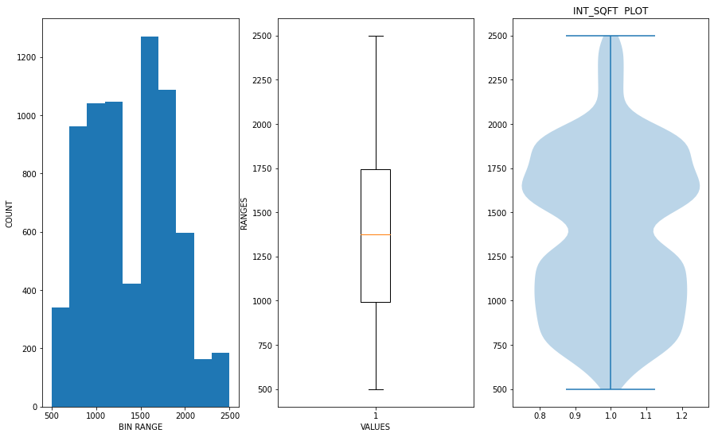
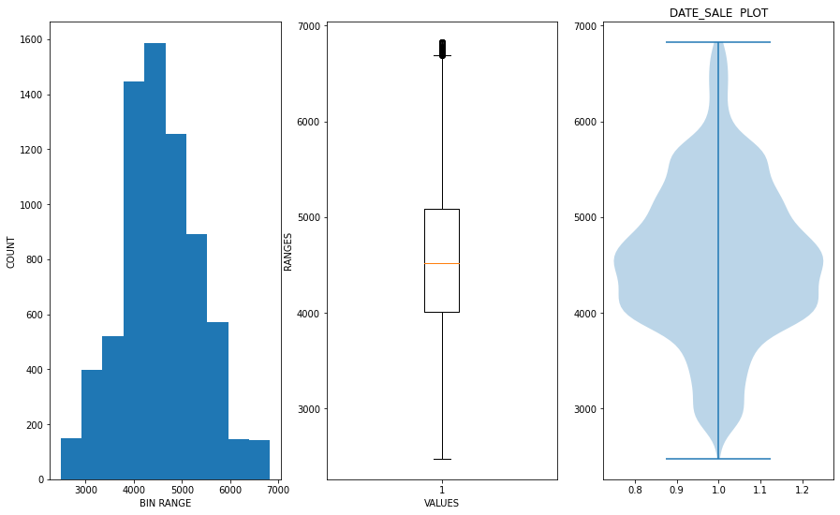
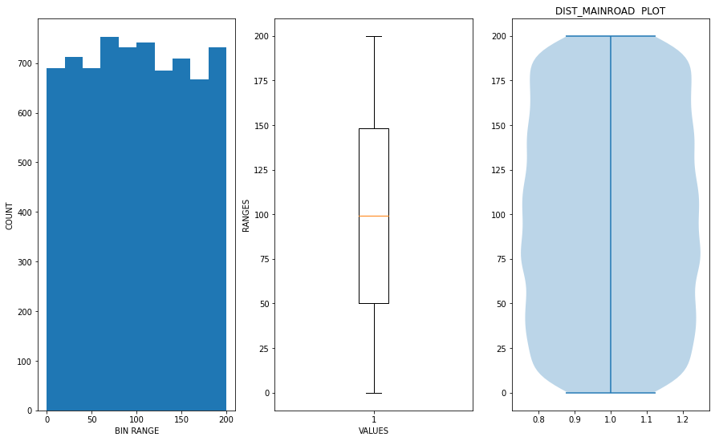
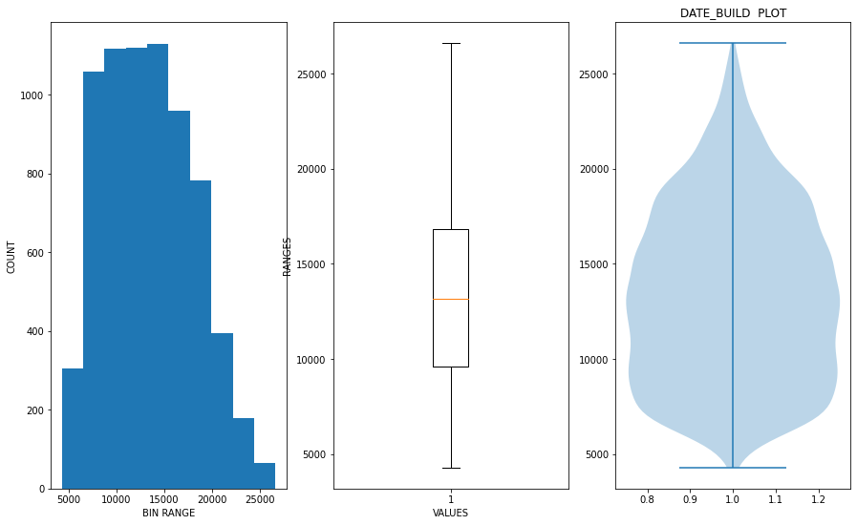

Slide 7
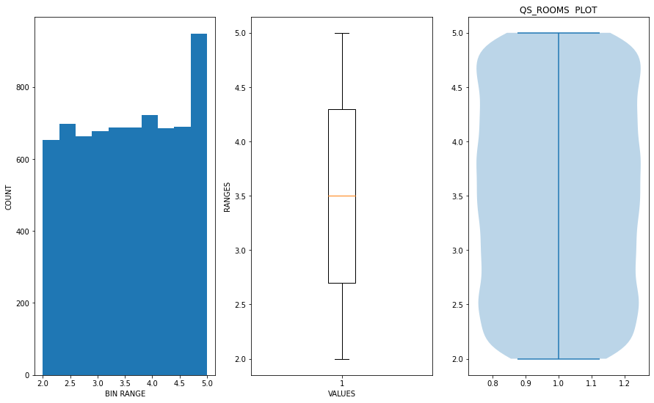
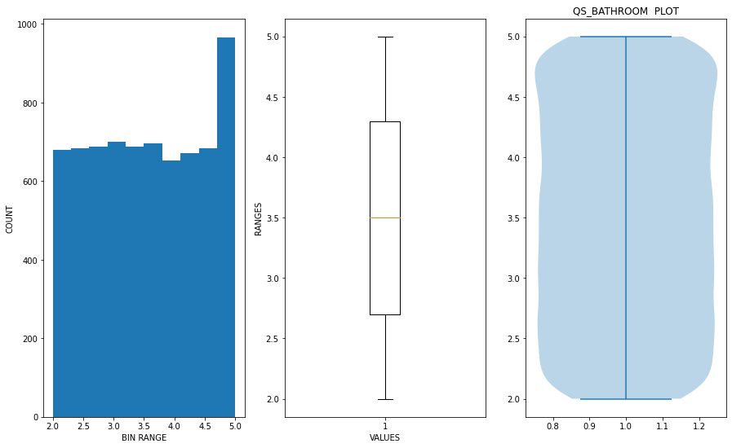
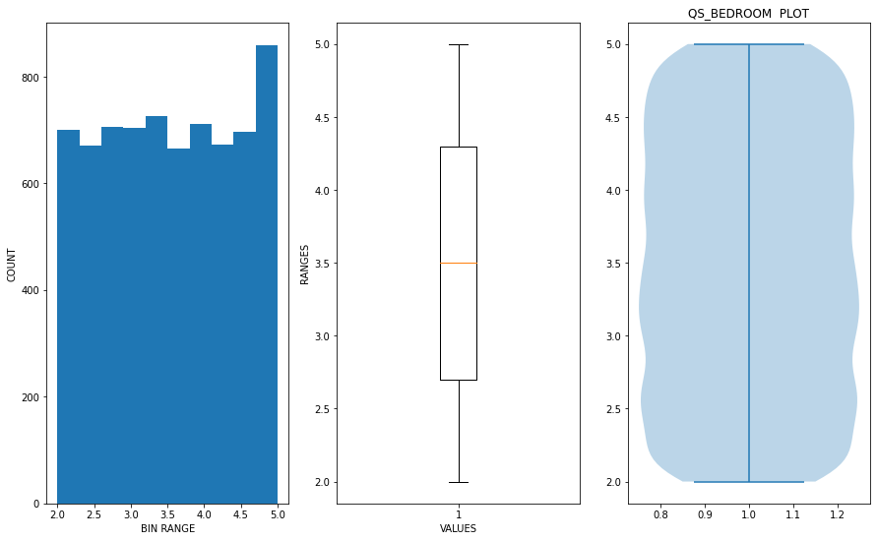
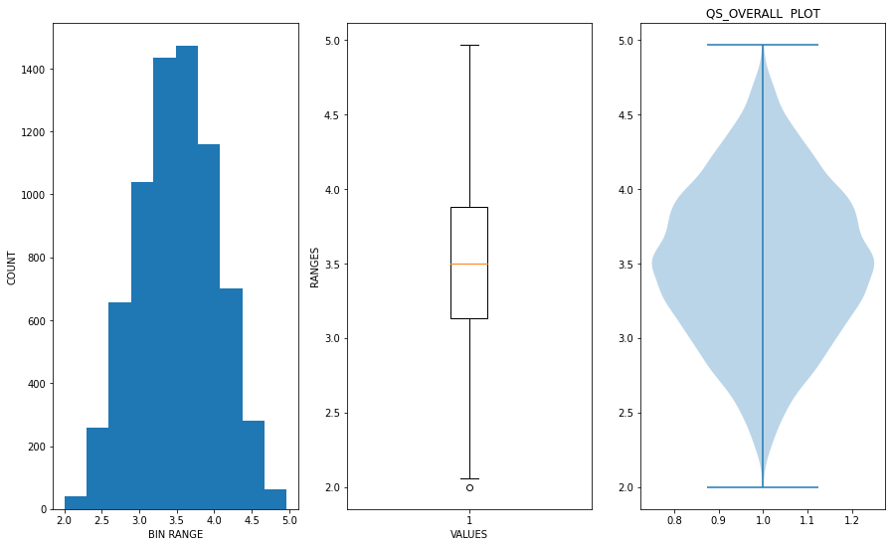

Slide 8
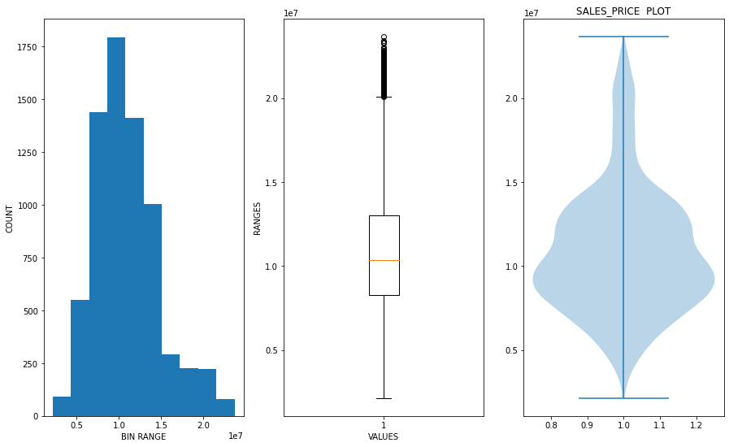

Slide 9
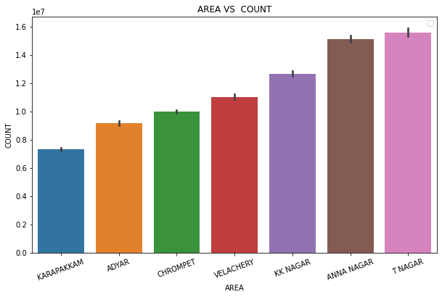
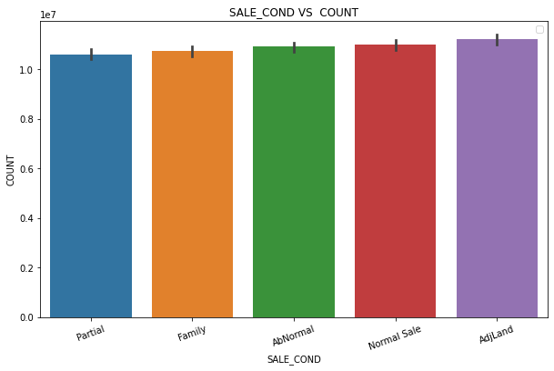
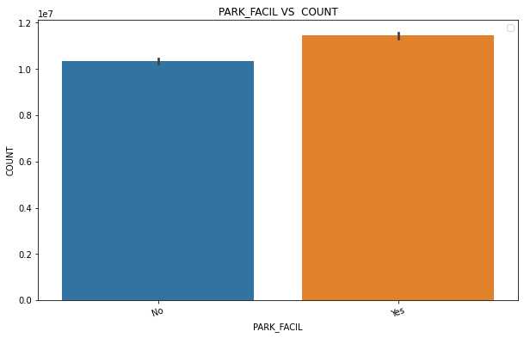
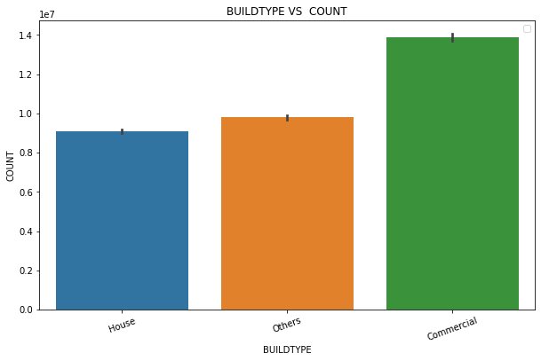
CATEGORICAL FEATURES VS LABEL EDA ANALYSIS:

Slide 10
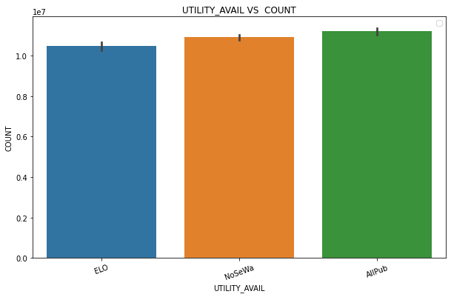
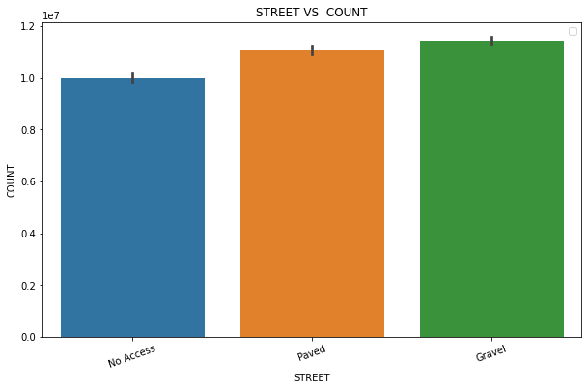
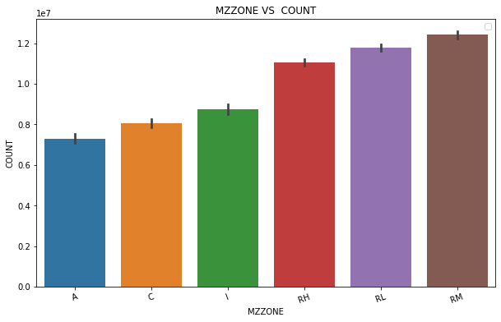
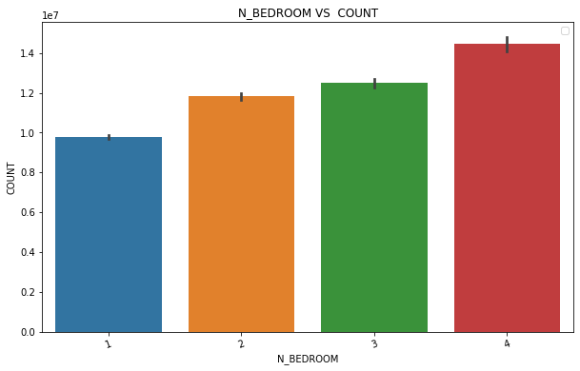

Slide 11
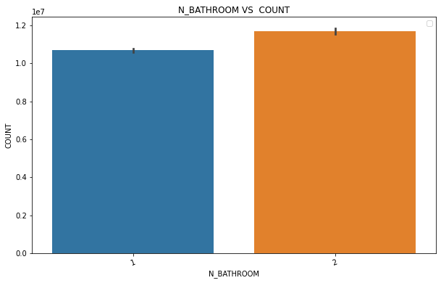
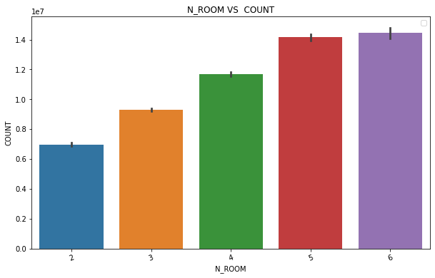

Slide 12
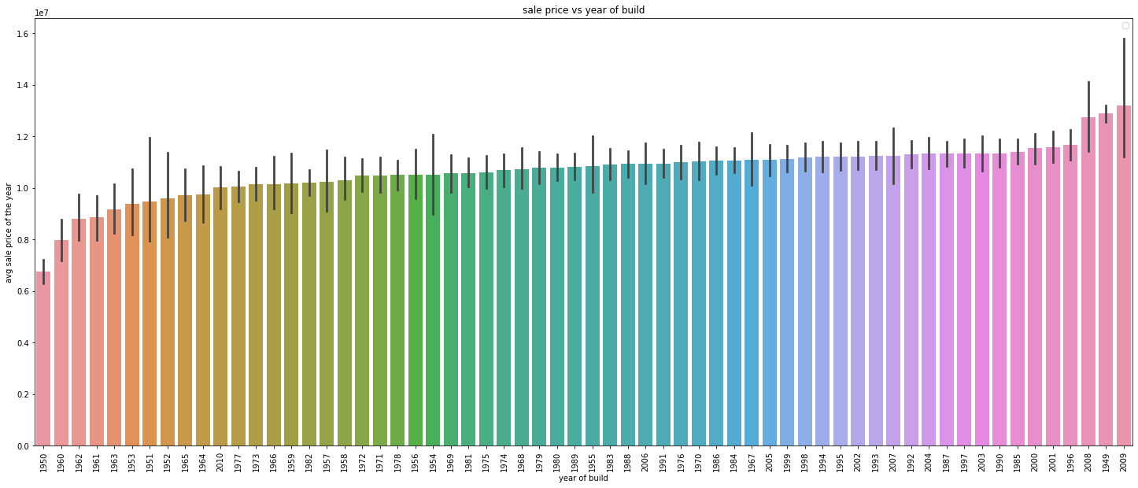
YEAR OF BUILD VS AVG LABEL EDA ANALYSIS:

Slide 13
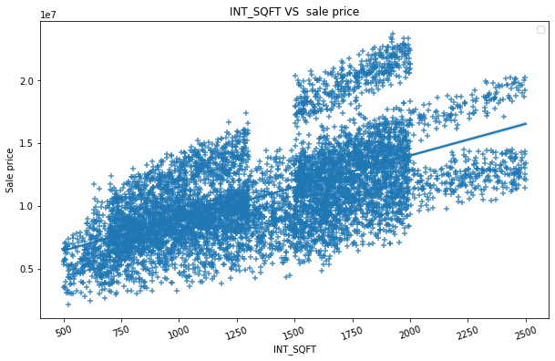
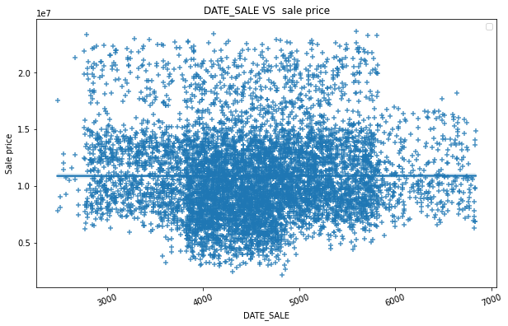
CONTINUOUS FEATURES VS LABEL EDA ANALYSIS:

Slide 14
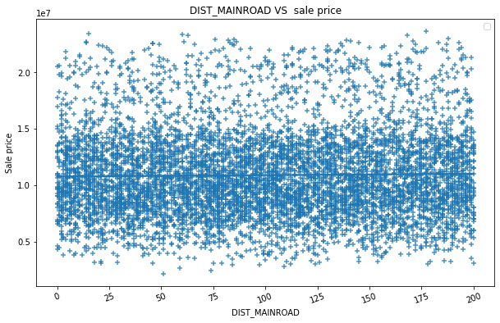
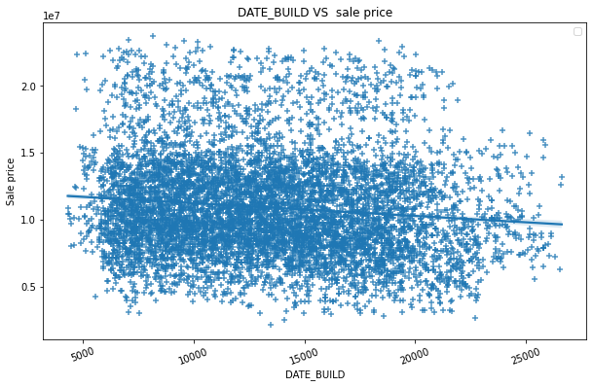

Slide 15
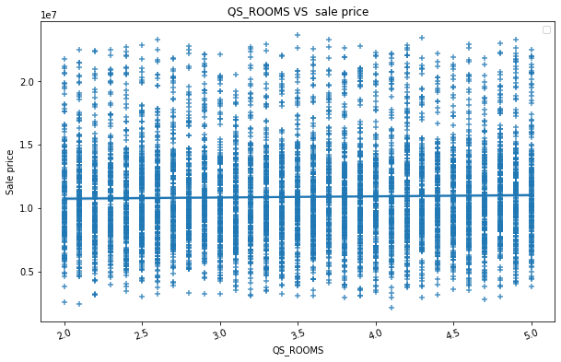
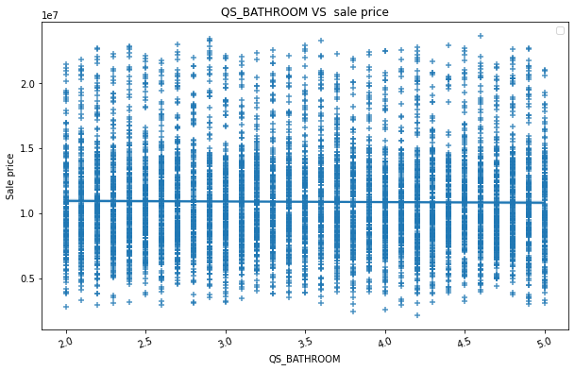
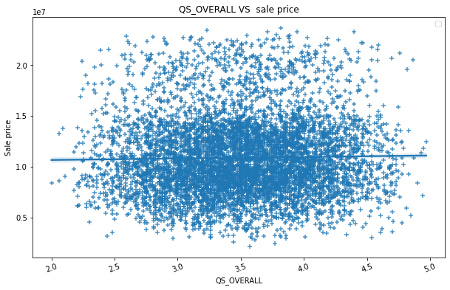
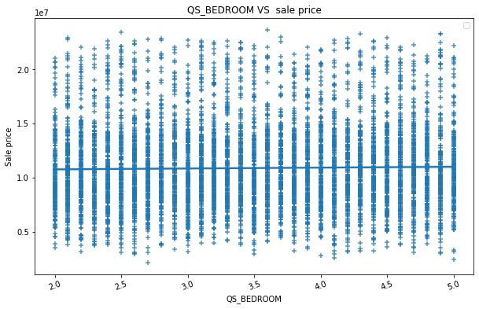

Slide 16
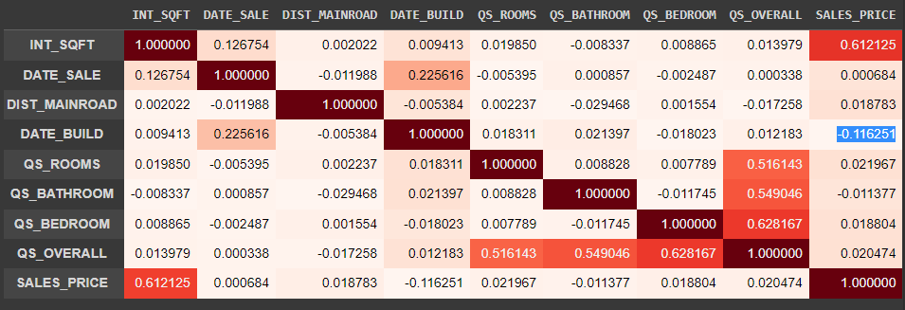
CORRELATION CHECK FOR CONTINUOUS FEATURES WITH LABEL:

Slide 17
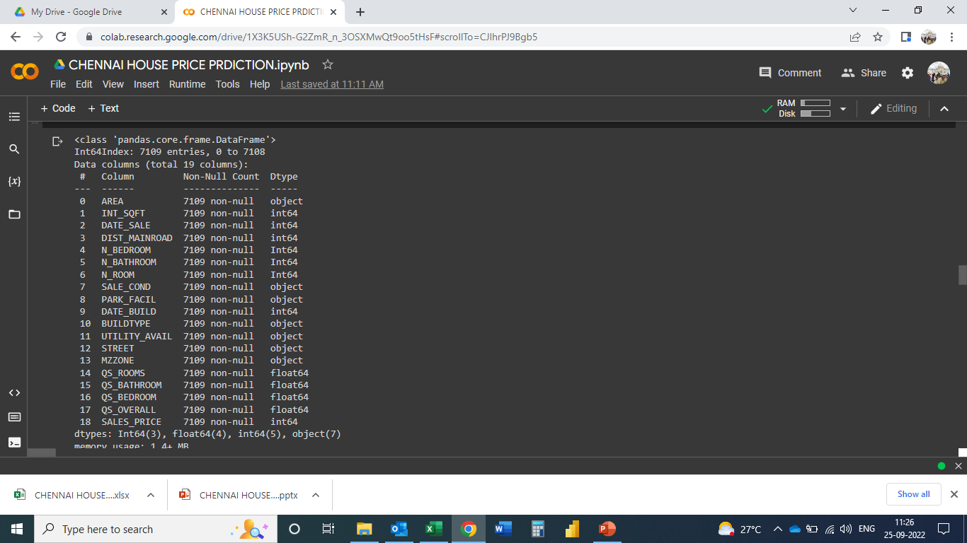
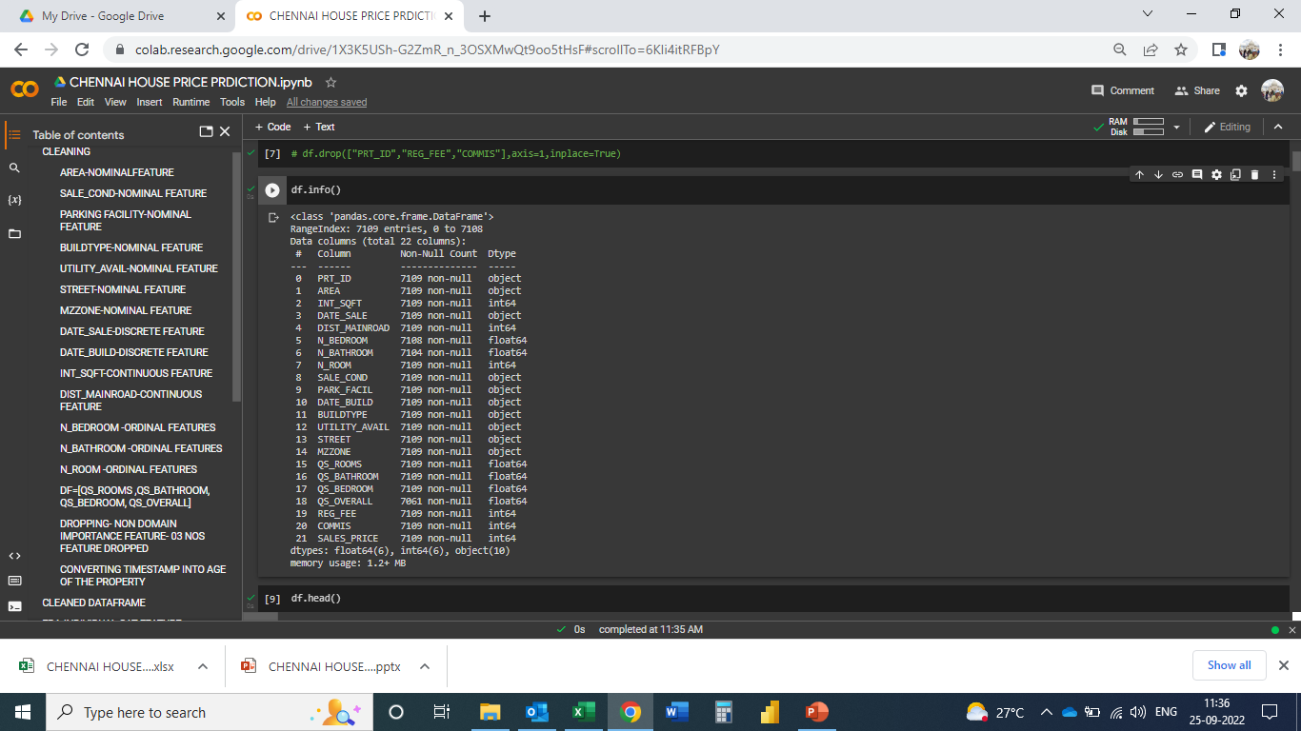
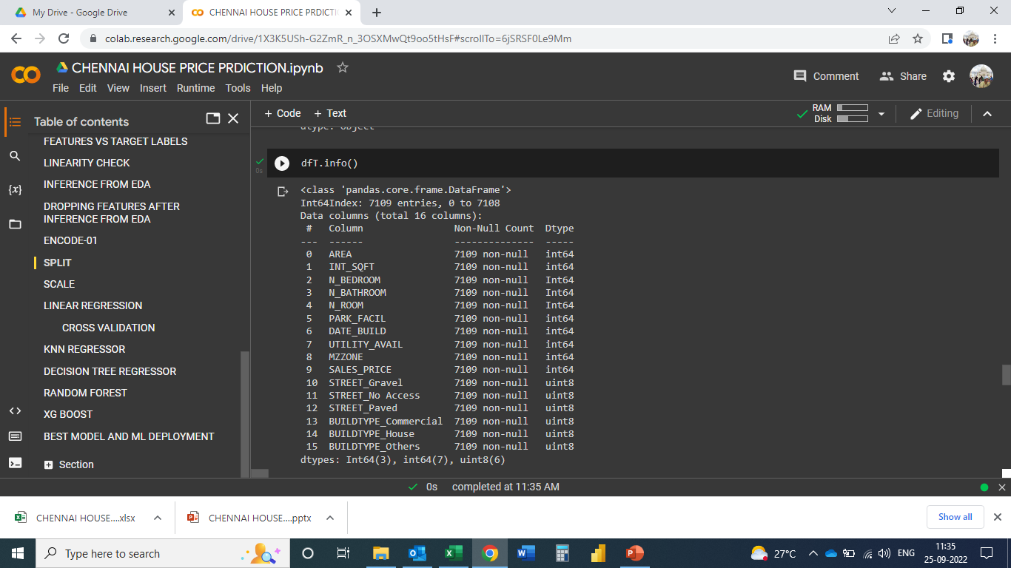
CLEANED DATAFRAME AFTER CLEANING/EDA/INFERENCE/DOMAIN INPUT/ENCODE:

Slide 18
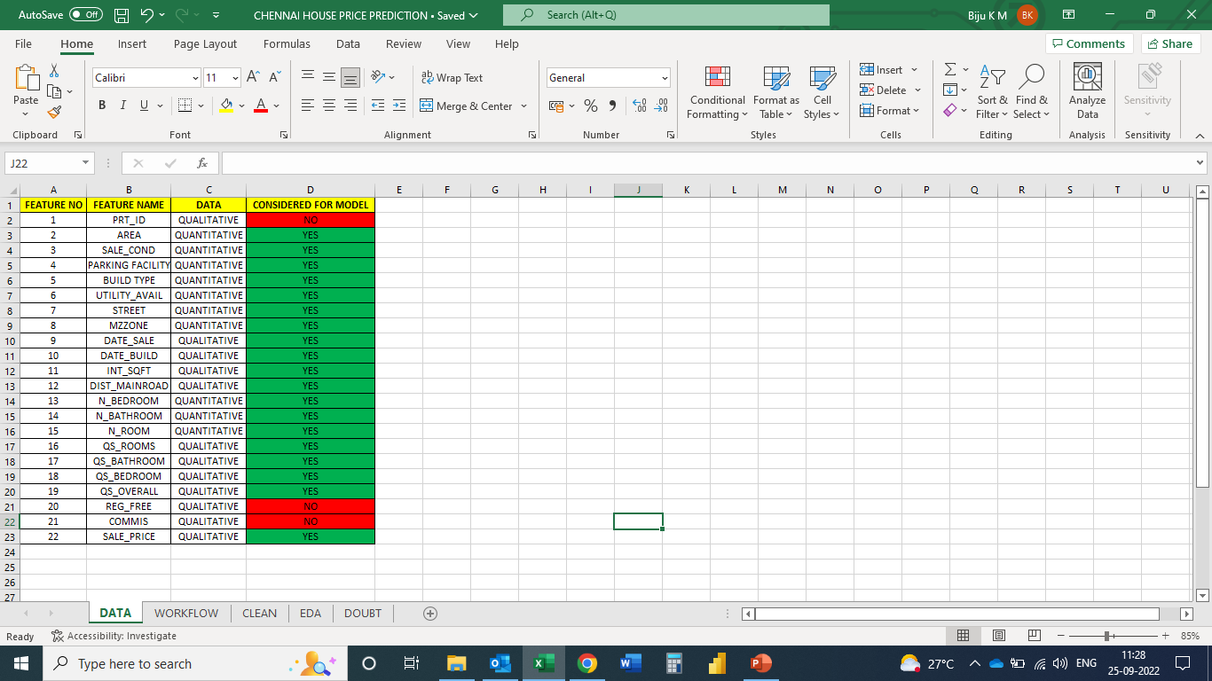
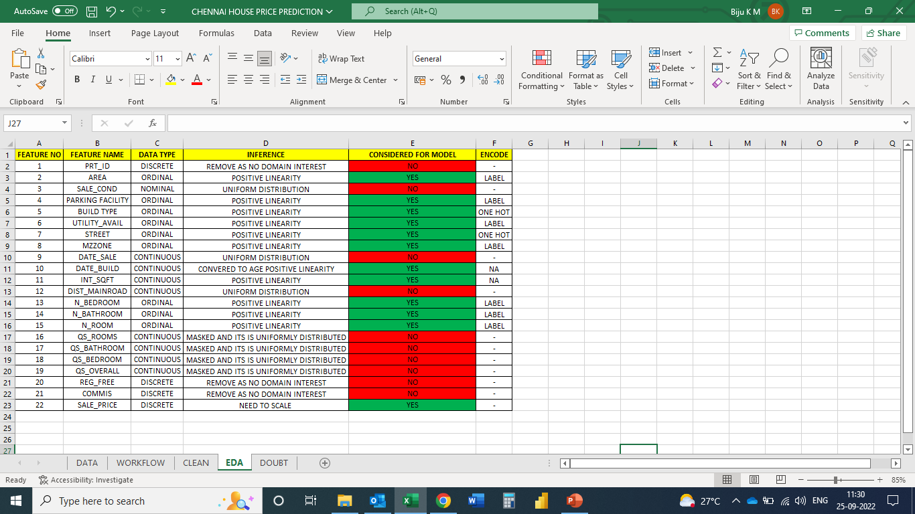
DATA SET
QUANTITATIVE DATA
QUALITATIVE DATA
NOMINAL DATA
ORDINAL DATA
DISCRETE DATA
CONTINUOUS DATA

Slide 19
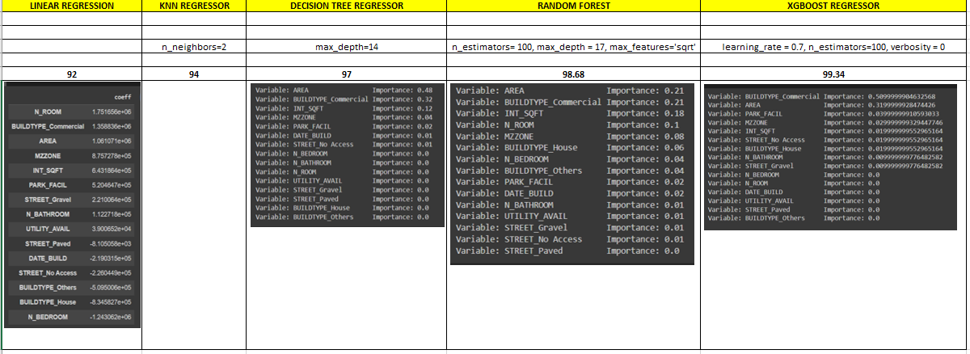

Slide 20
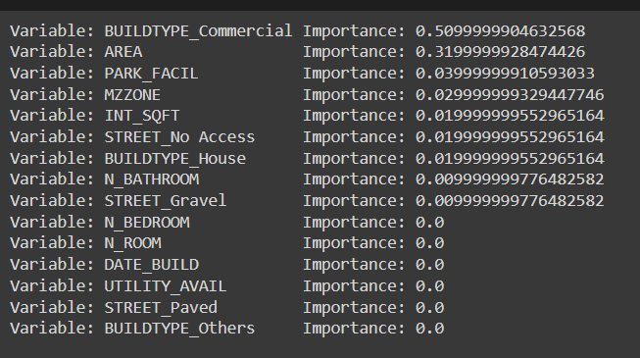
THE BEST MODE AND IMPORTANCE FEATURES:
XG BOOST WITH 99.34 % ACCURACY

Slide 21
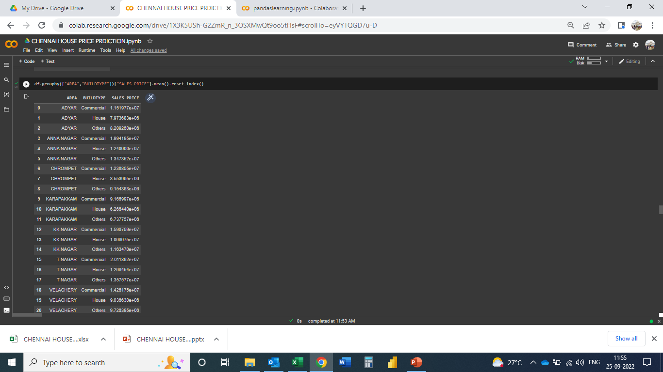
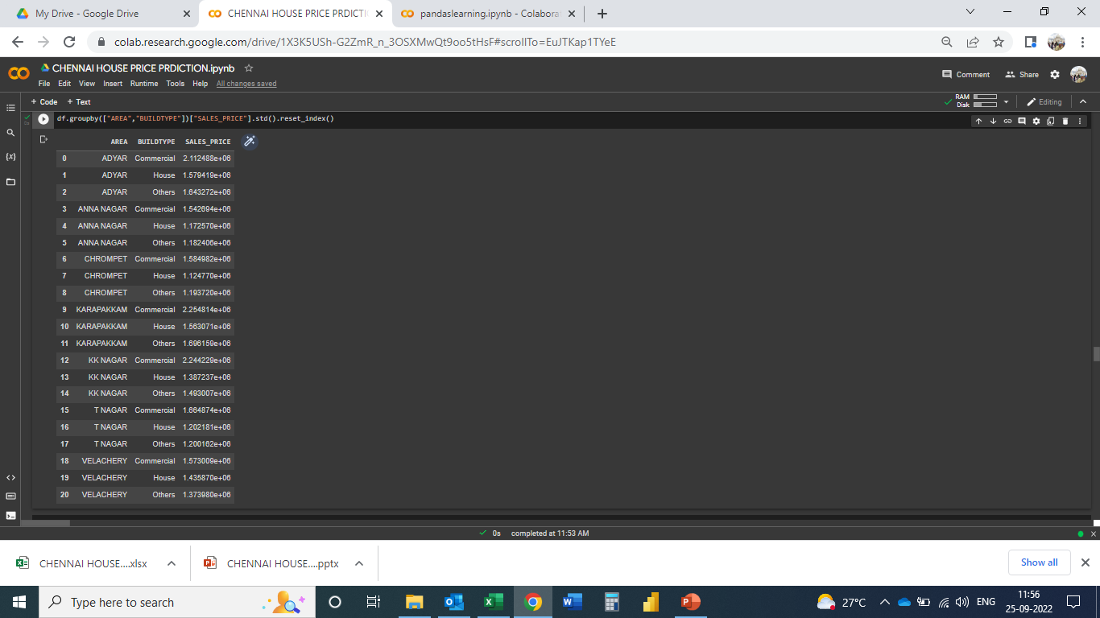
THE INTERVAL ESTIMATOR BASED ON TOP 2 FEATURES:

Slide 22
THE INTERVAL ESTIMATOR BASED ON TOP 2 FEATURES:
WITH 68% CONFIDENCE INTERVAL- MEAN+/- STD(1)
WITH 95% CONFIDENCE INTERVAL- MEAN+/-STD(2)
WITH 98% CONFIDENCE INTERVAL- MEAN+/-STD(3)

Slide 23


Slide 24
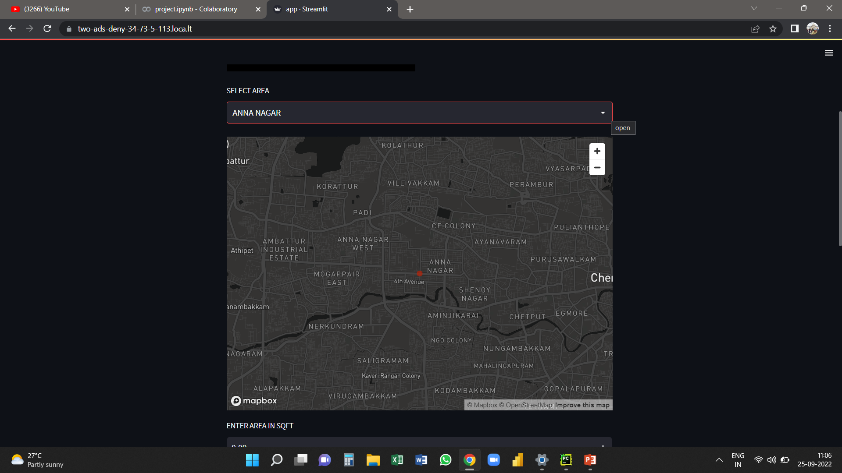

Slide 25


Slide 26


Slide 27


Slide 28


